Slide 1

Human Geography With Open GIS : A Transformative Introductory Higher Education Course
Dr. Joseph Holler Middlebury College, US

Slide 2
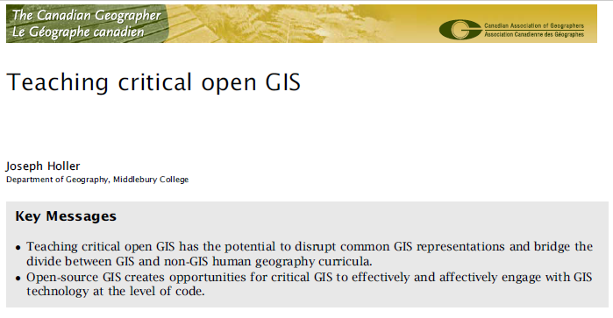
Open GIS for Development @ github.com/gis4dev
Skeptical Geographers:
Isn’t GIS only capitalist, imperialist, military-industrial, instrumentalist, surveillant, … tech incapable of multiple world views?
Skeptical Reviewers:
Is it possible to attempt this at introductory level?
Can a course really transform GIS while learning social theory?
Doi: 10.1111/cag.12521

Slide 3
Critical Human Geography & GIS
Human geography: radical
relativist
qualitative
post-modern
rejecting GIS
GIS: corporate
capitalist
positivist
surveillant
instrumentalist
divide

Slide 4
Critical Human Geography & GIS
Human geography: radical
relativist
qualitative
post-modern
rejecting GIS
GIS: corporate
capitalist
positivist
surveillant
instrumentalist
Human Geography w Open GIS: multiple, accessible, malleable GIS’s, transparent code as the text & history of social context
Open GIS to support Critical Research
GIS Lab as site of Transformation :
Curricula
Software
Students

Slide 5
transforming curricula
Learning goals, flow, student work & evaluation

Slide 6
Curricular learning goals
Understand & apply fundamental concepts in human geography and spatial analysis
Understand, apply & critique a range of thematic problems and applications of GIS in human geography
Develop skills interpreting & critiquing evidence
Solve problems independently by choosing the best methods and interpreting results
Gain familiarity with GIS and learning new GIS techniques
Appreciate error, uncertainty, and ethics in GIS.

Slide 7
Curricular flow established in part by Dr. Jeff Howarth
Th: Introduce new subdiscipline in human geography
Wknd: Video tutorial of simple examples
Wknd: Read critically applied GIS paper
Tu: Review GIS and plan GIS paper implementation
W: Interactive labs transfer reading to new context
Th: Interpret & critique lab findings
6. Independent Exam: solve spatial word problem with given data
Exam: solve spatial problem with GIS & theory

Slide 8
Transformed curricular flow: example of first 1.5 weeks
Introducing human geography, GIS, and cartography
Participatory Mapping of Disabled Access (Kitchin 2002)
Lab: Create schema, collect location & point feature data
Fundamentals of location, GPS, place, space
Video tutorial: data visualization with QGIS and QuickOSM
Critical Cartography (Crampton 2010) Cartographic Design
Lab: Cartographic Layout & Critique
6. Independent Exam: solve spatial word problem with given data

Slide 9
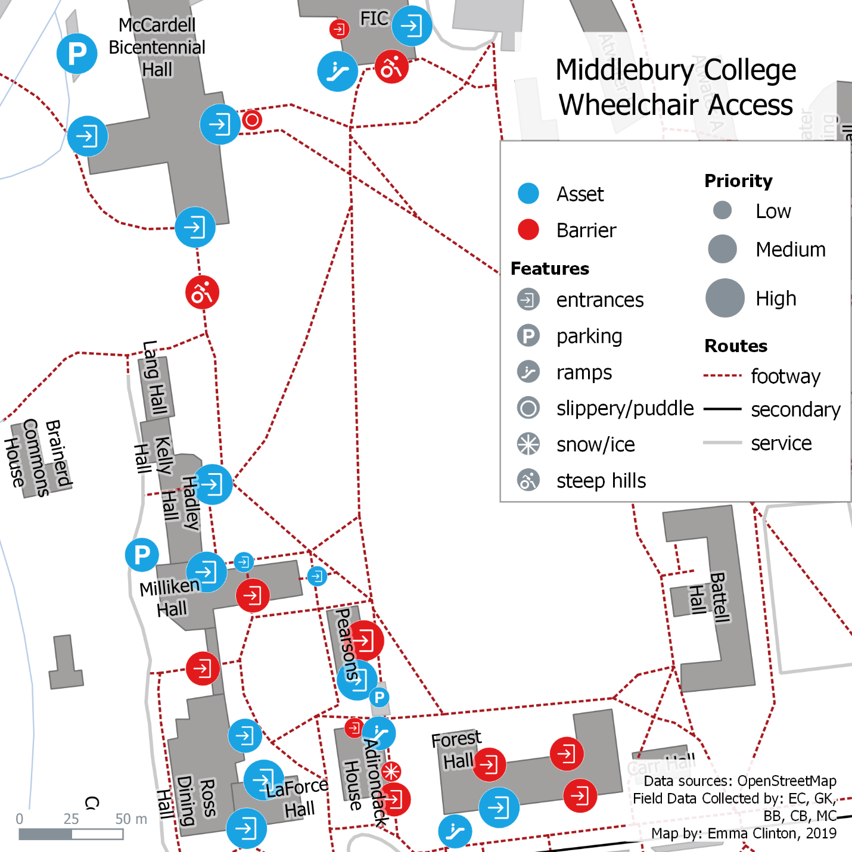
Students’ Accessibility Maps (Emma Clinton, Spring 2019)
Adapted schema and symbology to add winter hazards
Handicapped entrances difficult to find and blocked by snow/ice
Historic campus buildings inaccessible
Important student life functions inaccessible

Slide 10
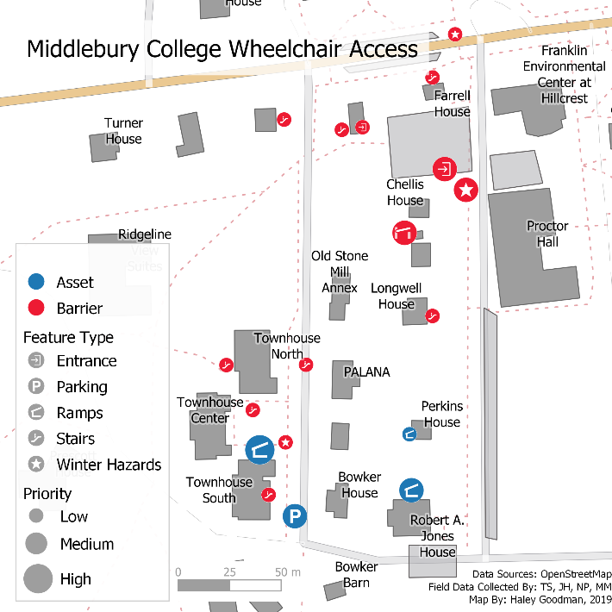
Students’ Accessibility Maps (Haley Goodman, Spring 2019)
Maps as socially produced
But critical cartographers can repurpose them…
With power to change perception of space
And planning the built environment

Slide 11
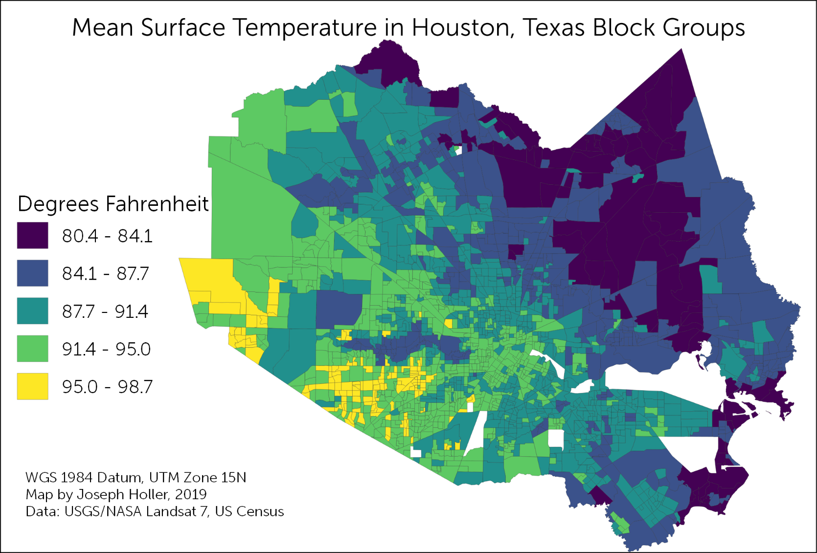
Evaluation: Independent Problem-Solving
After reading urban geography of urban structure/segregation and urban political ecology of tree canopy…
Is Houston, Texas segregated?
If so, is there evidence of environmental injustice in temperature?
Given: Census 2000 tracts with race data and surface temperature derived from Landsat 7 on Sept 6, 2000

Slide 12
Transformed Curricula
Human geography theory learned actively with Open GIS
GIS concepts and techniques taught & critiqued in context of human geography
GIS problems posed, solved, and interpreted with theory
Bridging divide between subdisciplines & epistemologies

Slide 13
transforming GIS
Features for pedagogy & simplicity
Debugging by professor & students

Slide 14
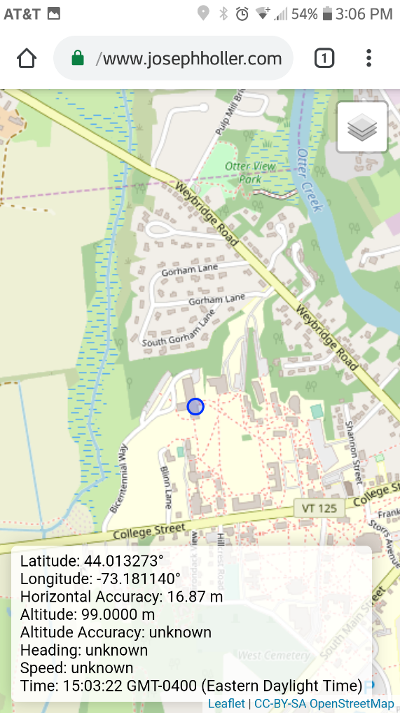
Leaflet Map Exposing Location Services
Need: simple map to expose location services for data collection
Solution: Leaflet map with information panel
Bonus: base map contains the same OSM data students will use for cartography

Slide 15
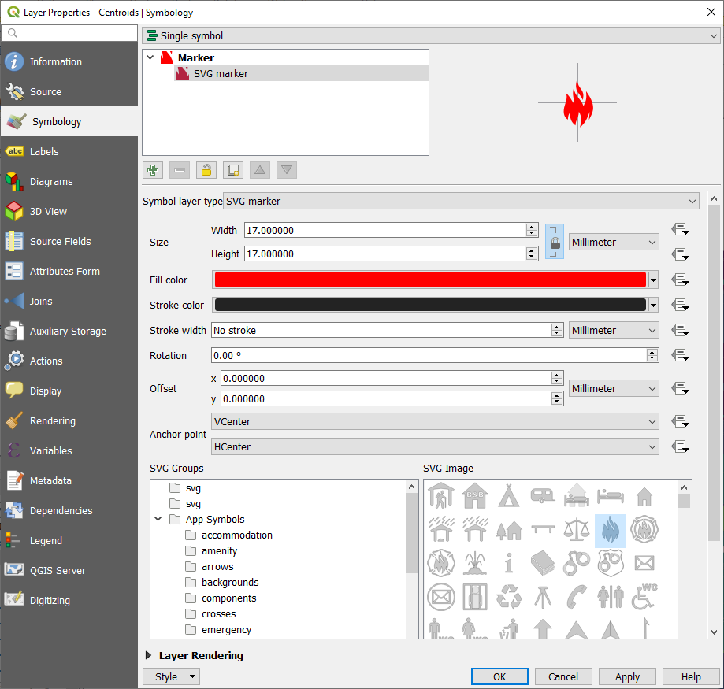
Maki Icons point symbology in QGIS
Need: better symbol set for point locations in QGIS
Solution: modify Mapbox Maki SVG code to talk to QGIS symbology + batch code to push into QGIS apps\qgis\svg
In each SVG: path fill=“param(fill)”…

Slide 16
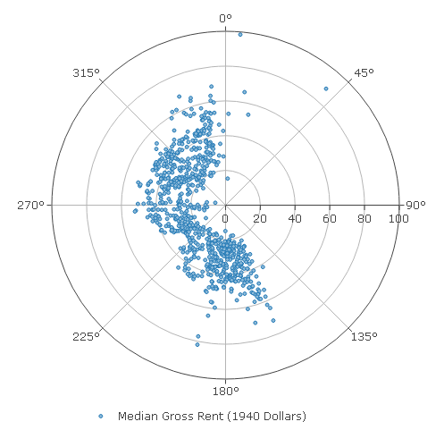
Data Plotly Revision to Polar Plots
Need: QGIS graph for analysis of Hoyt’s Sector Theory: race and housing by direction from central business district
Solution: modify Data Plotly polar plot
Set direction to clockwise
map independent variable x (direction from CBD) as theta and dependent variable y (rent) as r
'polar': {'angularaxis': {'direction': 'clockwise'}}
r=self.plot_properties['y'], theta=self.plot_properties['x']

Slide 17
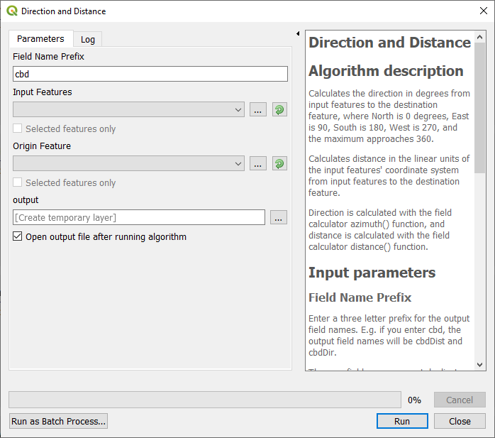
Prototype new algorithms to facilitate teaching
We can execute SQL to use ST_MakeValid() and group by, but novice students cannot…
Dissolve
Robust against geometry errors
Group by many fields
Many summary statistics for many summary fields
Distance and Direction
Facilitate field calculator azimuth() and distance() functions with references to 2nd layer for introductory students
Documentation supports teaching concepts

Slide 18
Debugging GeoPackages in QGIS 3.4
Prepare tutorials with simple data and edge cases, finding…
Core vector processing algorithms assumed FID was unique
Problem for Intersection, Union
Buffer w/ dissolve violated geometry type constraints
Other bugs frustrate novices
Some state plane CRS not supported
Feature counts don’t function for layers created as algorithm outputs
Critical errors all fixed by 3.7

Slide 19
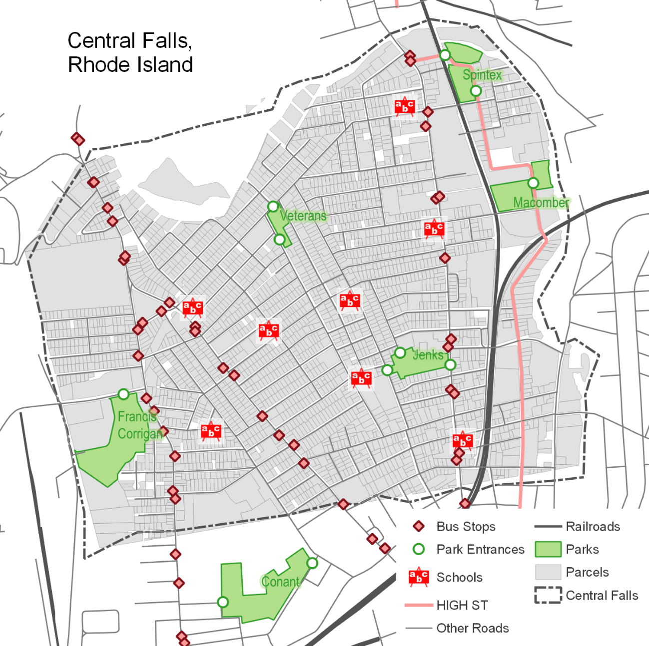
Debugging QNEAT3 Plugin
Train students to observe inputs, outputs, and descriptive statistics for independent GIS problems
They notice QNEAT3 OD Matrix is always missing one record
GitHub Bug Report submitted, fixed & tested within 6 days
CRS errors & Iso-areas algorithms can be improved

Slide 20
Transforming students

Slide 21
Transforming Students
Set stage for independent research integrating geographic theory & techniques
Better GIS analysts:
Aware of subjectivity, error, uncertainty;
Developing problem-solving skills
Strategies to recognize errors and troubleshoot/debug
Interpret problem and results with theory
Independence & freedom for:
Entrepreneurship
Not-for profit & grassroots
Data science

Slide 22
Thank you
GitHub: GIS4DEV
Email: josephh@middlebury.edu

